Slide 1
System models
Context model
Behavioral models
Data and object models
Structured methods

Slide 2
System Modeling
System modeling is the process of developing abstract models of a system, with each model presenting a different view or perspective of that system.
System modeling mean representing a system using some kind of graphical notation, which is now almost always based on notations in the Unified Modeling Language (UML).
System modelling helps the analyst to understand the functionality of the system and models are used to communicate with customers.

Slide 3
System Modeling
Models are used:-
during the requirements engineering process to help derive the requirements for a system
during the design process to describe the system to engineers implementing the system and
after implementation to document the system’s structure and operation

Slide 4
System Modeling
They help clarify what the existing system does and can be used as a basis for discussing its strengths and weaknesses which can lead to requirements for the new system.
Models of the new system used during requirements engineering help to explain the proposed requirements to other system stakeholders [Engineers use these models to discuss design proposals and to document the system for implementation]

Slide 5
System Perspectives
An external perspective, where you model the context or environment of the system.
An interaction perspective, where you model the interactions between a system and its environment, or between the components of a system.
A structural perspective, where you model the organization of a system or the structure of the data that is processed by the system.
A behavioral perspective, where you model the dynamic behavior of the system and how it responds to events.

Slide 6
UML Diagram Types
Activity diagrams, which show the activities involved in a process or in data processing .
Use case diagrams, which show the interactions between a system and its environment.
Sequence diagrams, which show interactions between actors and the system and between system components.
Class diagrams, which show the object classes in the system and the associations between these classes.
State diagrams, which show how the system reacts to internal and external events.

Slide 7
2.1 Context Models
Context models are used to illustrate the operational context of a system - they show what lies outside the system boundaries.
Social and organizational concerns may affect the decision on where to position system boundaries.
Context models simply show the other systems in the environment, not how the system being developed is used in that environment.

Slide 8
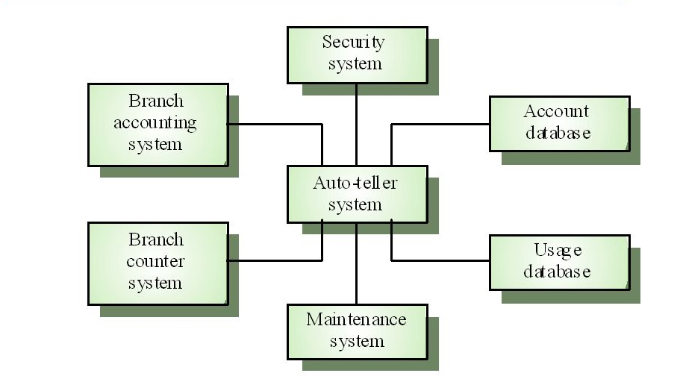
Context model-ATM System

Slide 9
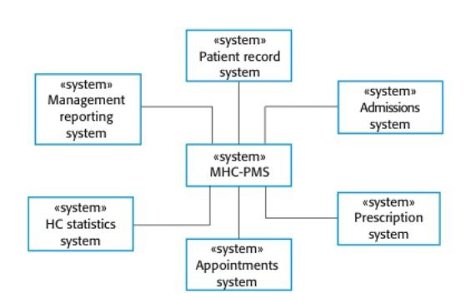
Context of MHC-PMS (Medical Health Care Patient Management System)

Slide 10
2.2 Behavioral Models
Behavioral models are models of the dynamic behavior of a system as it is executing.
They show what happens or what is supposed to happen when a system responds to a stimulus from its environment.
Two types of stimuli:
Data->Some data arrives that has to be processed by the system.
Event->Some event happens that triggers system processing. Events may have associated data, although this is not always the case.

Slide 11
Behavioral Models-Data Driven
Data-driven models show the sequence of actions involved in processing input data and generating the associated output.
This is very useful during the analysis stage since they show end-to-end processing in a system which means that they show the entire action sequence of how input data become output data i.e. it shows the response of the system to particular input.
In UML, activity and sequence diagrams can be used to describe such data flows.

Slide 12
Behavioral Models-Event Driven
Event-driven modeling shows how a system responds to external and internal events (stimuli)
It is based on the assumption that a system has a finite number of states and that an event (stimulus) may cause a transition from one state to another
The UML supports event-based modeling using state machine diagrams

Slide 13
Data Model
Data modeling in software engineering is the process of creating a data model for an information system by applying certain formal techniques.
It is used to define and analyze data requirements needed to support the business processes within the scope of corresponding information systems in organizations.
UML diagrams, ER-diagram, Data flow diagram assists data modeling.

Slide 14
Uses of data model
To assist in understanding and use an agreed upon semi-formal model that encompasses the concepts of the organization and how they relate to one another
To manage data as a resource
To integrate information systems
To design databases/data warehouses (aka data repositories)

Slide 15
Object Models
Object models describe the system in terms of object classes and their associations.
An object class is an abstraction over a set of objects with common attributes and the services (operations) provided by each object.
An object data model provides support for objects as the basis for modeling in a database application.
Various Object model may be produced: 1. Inheritance model, 2. Aggregation model, 3. Interaction model.
Object-diagram assists object modeling.

Slide 16
Object Model
An object is an instance of a class, which is a complex type specification that defines both the state of its instance fields and the behavior provided by its methods.
Object features also include a unique object identifier that can be used to refer to the object, as well as the organization of data into class hierarchies that support inheritance of state and behavior.
Object data model encompasses the data model for both object-oriented databases and object-relational databases.

Slide 17
Structured methods
Structured methods were invented to support function-oriented design
Structured ‘methods’ are really standard notations and embodiments of good practice.
Following these methods and applying the guidelines can result in a reasonable design.
A structured method includes a design process model, notations to represent the design, report formats, rules and design guidelines.
Structured methods may support some or all of the following models of a system:-(next slide)

Slide 18
Structured Methods
An object model that shows the object classes used in the system and their dependencies.
A sequence model that shows how objects in the system interact when the system is executing.
A state transition model that shows system states and the triggers for the transitions from one state to another.

Slide 19
Structured Methods
A structural model where the system components and their aggregations are documented.
A data flow model where the system is modeled using the data transformations that take place as it is processed [frequently used in real-time and business system design also]
A use-case model that shows the interactions between users and the system.
[The unification of different structured methods for object oriented design led to the development of the UML]

Slide 20
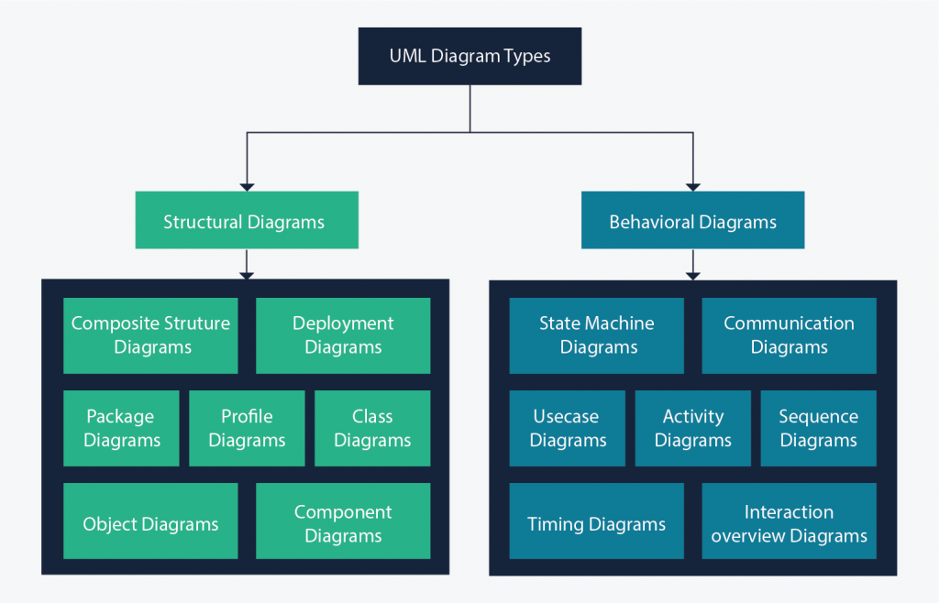
UML Modeling Diagrams

Slide 21
UML Diagrams
Structure diagrams show the things in the modeled system. In a more technical term, they show different objects in a system.
Behavioral diagrams show what should happen in a system. They describe how the objects interact with each other to create a functioning system.

Slide 22
Use Case Modeling
Use cases were developed originally to support requirements elicitation and now incorporated into the UML.
Each use case represents a discrete task that involves external interaction with a system.
Actors in a use case may be people or other systems.
Use cases can be represented using a UML use case diagram and in a more detailed textual/tabular format.

Slide 23

Simple Use Case for MHC-PMS

Slide 24
Use Case Description (in tabular format)
Use case title | Transfer data
Description | A receptionist may transfer data from the MHC-PMS to a general patient record database that is maintained by a health authority. The information transferred may either be updated personal information (address, phone number, etc.) or a summary of the patient's diagnosis and treatment.
Actor(s) | Medical receptionist, patient records system (PRS)
Preconditions | Patient data has been collected (personal information, treatment summary); The receptionist must have appropriate security permissions to access the patient information and the PRS.
Postconditions | PRS has been updated
Main success scenario | 1. Receptionist selects the "Transfer data" option from the menu. 2. PRS verifies the security credentials of the receptionist. 3. Data is transferred. 4. PRS has been updated.
Extensions | 2a. The receptionist does not have the necessary security credentials. 2a.1. An error message is displayed. 2a.2. The receptionist backs out of the use case.

Slide 25
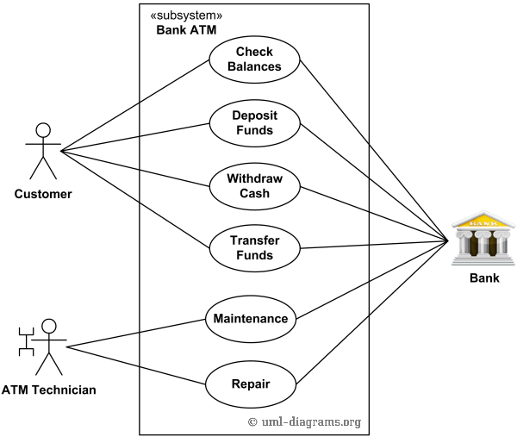
Use Case Diagram for ATM

Slide 26
Sequence Diagrams
UML sequence diagrams are used to model the interactions between the actors and the objects within a system.
A sequence diagram shows the sequence of interactions that take place during a particular use case or use case instance.
The objects and actors involved are listed along the top of the diagram, with a dotted line drawn vertically from these.
Interactions between objects are indicated by annotated arrows.

Slide 27
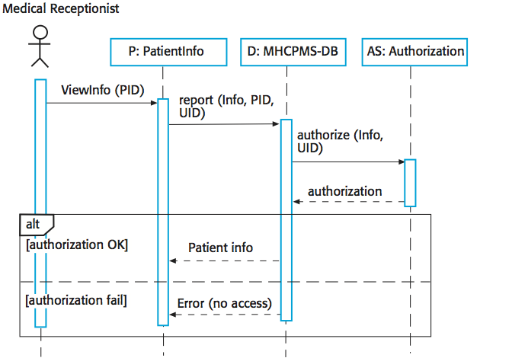
Sequence diagram for View patient information

Slide 28
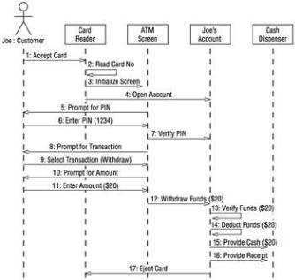
Sequence Diagram for ATM System

Slide 29
Structural models
Structural models of software display the organization of a system in terms of the components that make up that system and their relationships.
Structural models may be static models, which show the structure of the system design, or dynamic models, which show the organization of the system when it is executing.
You create structural models of a system when you are discussing and designing the system architecture.

Slide 30
Class Diagrams
Class diagrams are the main building block of any object-oriented solution.
It shows the classes in a system, attributes, and operations of each class and the relationship between each class.
A class has three parts, Name at the top, attributes in the middle and operations or methods at the bottom.
In a large system with many related classes, classes are grouped together to create class diagrams.
Different relationships between classes are shown by different types of arrows.

Slide 31
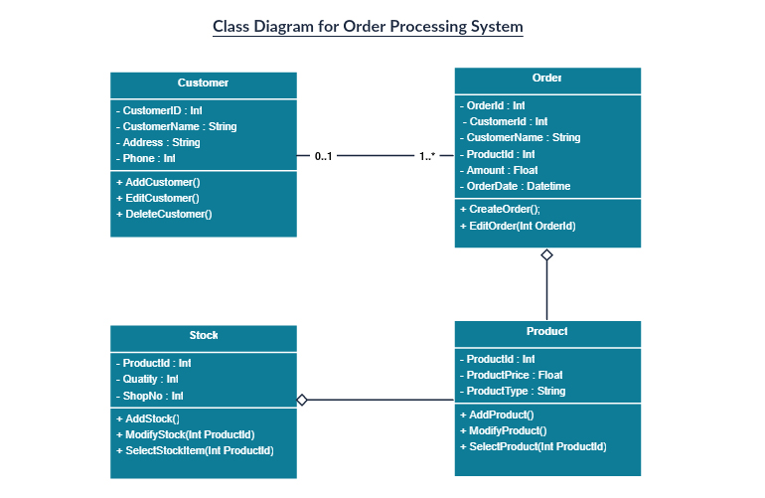
Class Diagram

Slide 32
Component diagram
A component diagram displays the structural relationship of components of a software system.
These are mostly used when working with complex systems with many components. Components communicate with each other using interfaces.
The interfaces are linked using connectors.

Slide 33
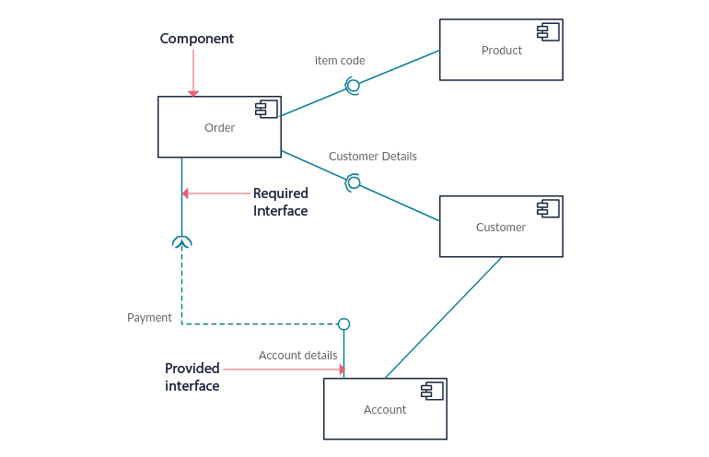
Component Diagram

Slide 34
Object Diagrams
Object Diagrams, sometimes referred to as Instance diagrams are very similar to class diagrams.
Like class diagrams, they also show the relationship between objects but they use real-world examples.
They show how a system will look like at a given time.
There is data available in the objects so they are used to explain complex relationships between objects.

Slide 35
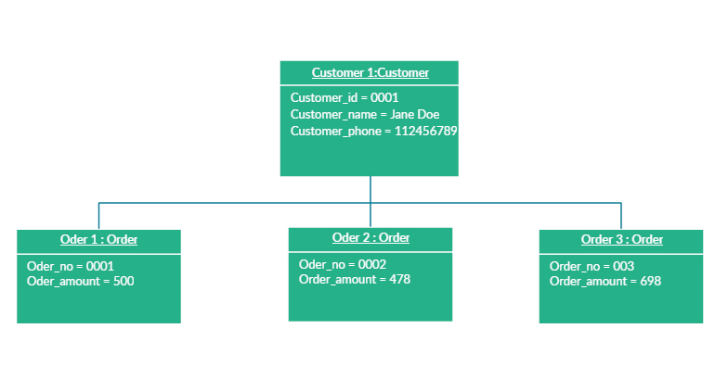
Object Diagram

Slide 36
Use case diagram
Use case diagrams give a graphic overview of the actors involved in a system, different functions needed by those actors and how these different functions interact.
It’s a great starting point for any project discussion because you can easily identify the main actors involved and the main processes of the system.

Slide 37
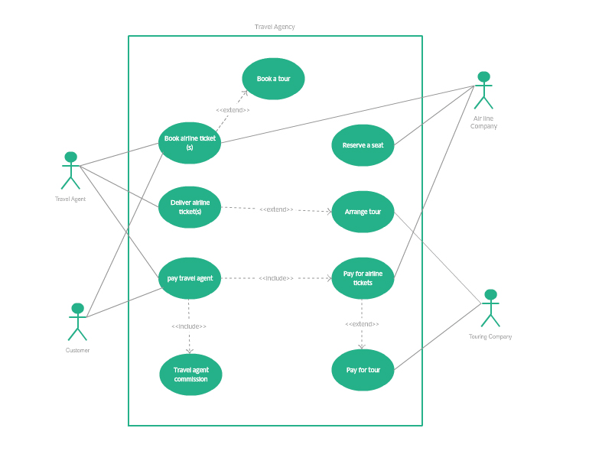

Slide 38
Activity diagram
Activity diagrams represent workflows in a graphical way.
They can be used to describe the business workflow or the operational workflow of any component in a system.
Sometimes activity diagrams are used as an alternative to State machine diagrams.

Slide 39
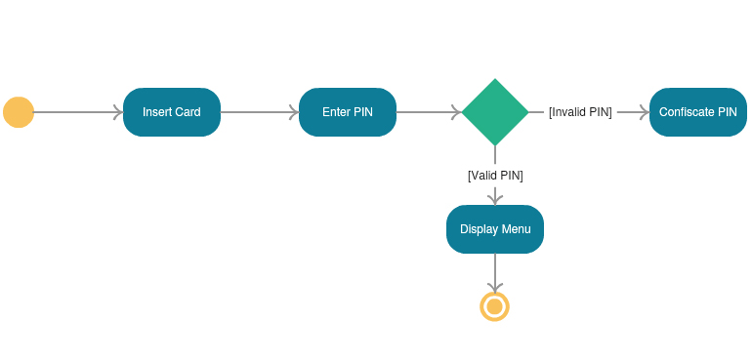
Activity Diagram

Slide 40
State Machine Diagram
State machine diagrams are similar to activity diagrams, although notations and usage change a bit.
They are sometimes known as state diagrams or state chart diagrams as well.
These are very useful to describe the behavior of objects that act differently according to the state they are in at the moment.

Slide 41
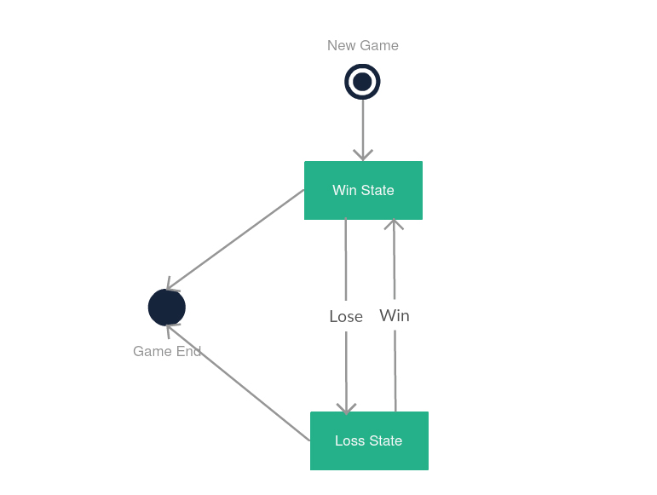
State Machine Diagram

Slide 42
Data Flow Diagram (DFD)
A DFD is a way of representing a flow of data through a process or a system (usually an information system).
The DFD also provides information about the outputs and inputs of each entity and the process itself.
It has no control flow, there are no decision rules and no loops.

Slide 43
Data flow Diagram
Also known as bubble chart
DFDs may be partitioned into levels that represent increasing information flow and functional detail.
Levels in DFD are numbered 0, 1, 2 or beyond.

Slide 44
0-Level
It is also known as fundamental system model, or context diagram represents the entire software requirement as a single bubble with input and output data denoted by incoming and outgoing arrows.
Then the system is decomposed and described as a DFD with multiple bubbles.
Parts of the system represented by each of these bubbles are then decomposed and documented as more and more detailed DFDs.

Slide 45
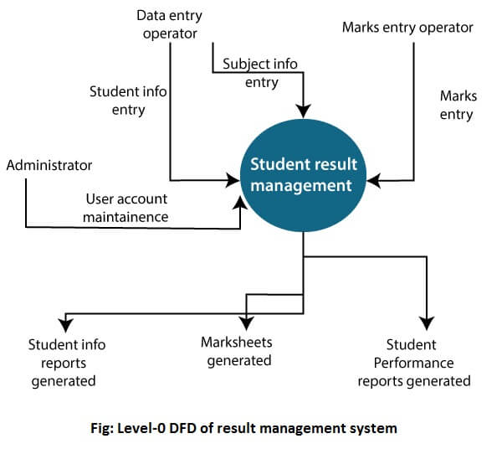
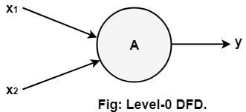
0-level

Slide 46
1-level
In 1-level DFD, a context diagram is decomposed into multiple bubbles/processes. In this level, we highlight the main objectives of the system and breakdown the high-level process of 0-level DFD into subprocesses.

Slide 47
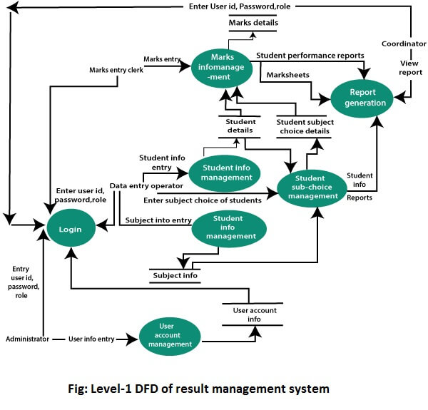

Slide 48
2-level
2-level DFD goes one process deeper into parts of 1-level DFD. It can be used to project or record the specific/necessary detail about the system's functioning.

Slide 49
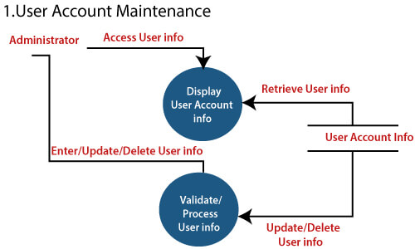
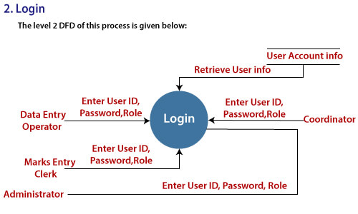
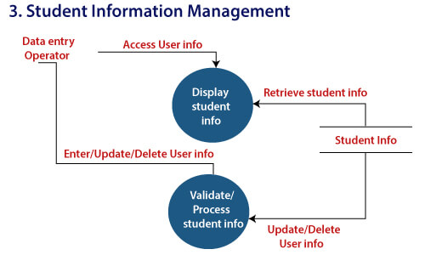
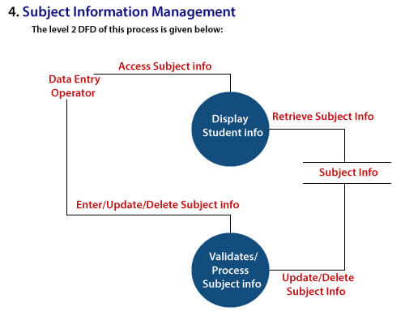

Slide 50
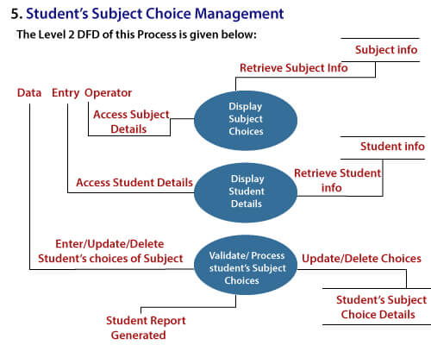
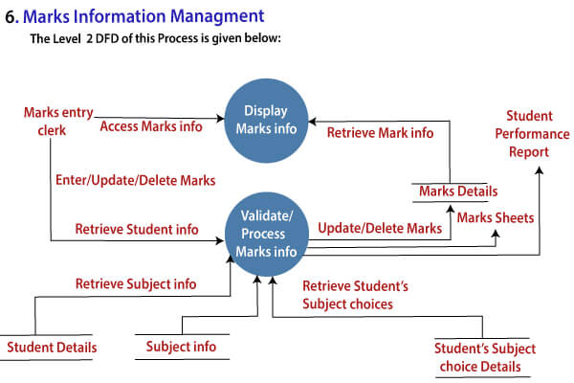

Slide 51
Assignment 2
Define system modeling. Explain different perspective of system.
What are different models used in system modeling? Explain with examples of each.
Explain different levels (0 and 1) of DFD with example.

